Slide 1
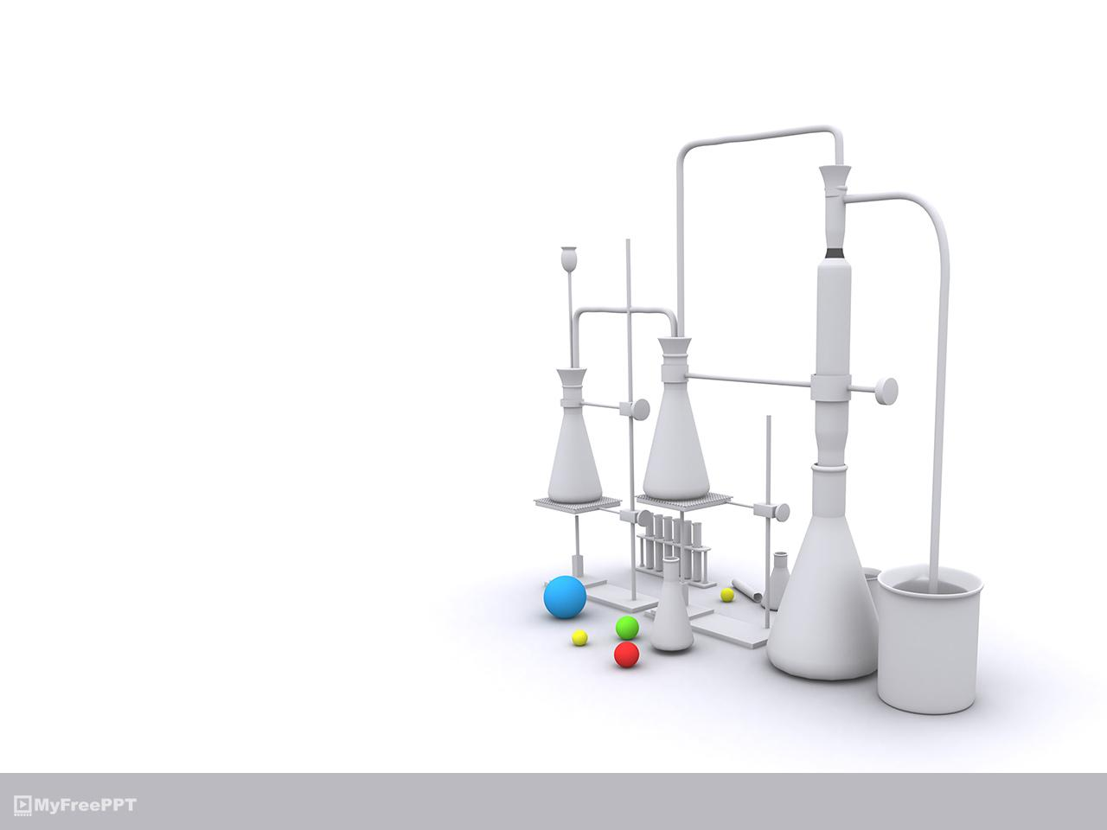
Containing West Nile Virus in Chicago
Done by: Wilson
William
Su Ying
Chun Wai
Disease And Treatment Agency, division of Societal Cures In Epidemiology and New Creative Engineering (DATA-SCIENCE)

Slide 2
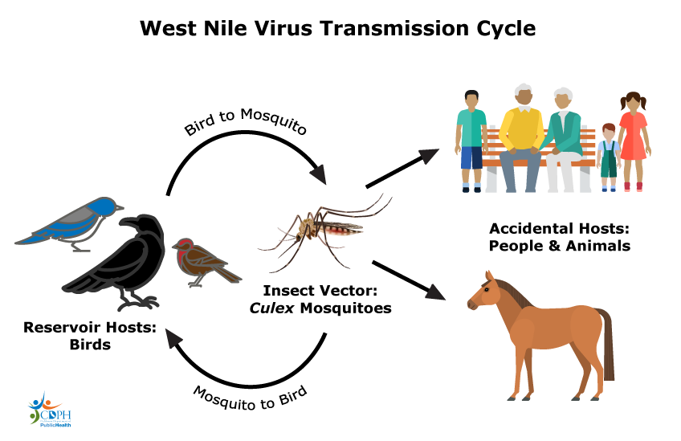
Introduction
West Nile virus (WNV) is a single-stranded RNA virus that causes West Nile fever. It is a member of the family Flaviviridae, specifically from the genus Flavivirus, which also contains the Zika virus, dengue virus, and yellow fever virus. West Nile virus is primarily transmitted by mosquitoes, mostly species of the genus Culex. The primary hosts of WNV are birds, so that the virus remains within a "bird–mosquito bird" transmission cycle
https://en.wikipedia.org/wiki/West_Nile_virus

Slide 3
Introduction
Agenda
Problem Statement
Data and constraints
Modelling , Prediction and Results
Cost Benefit Analysis
Conclusions and Recommendations

Slide 4
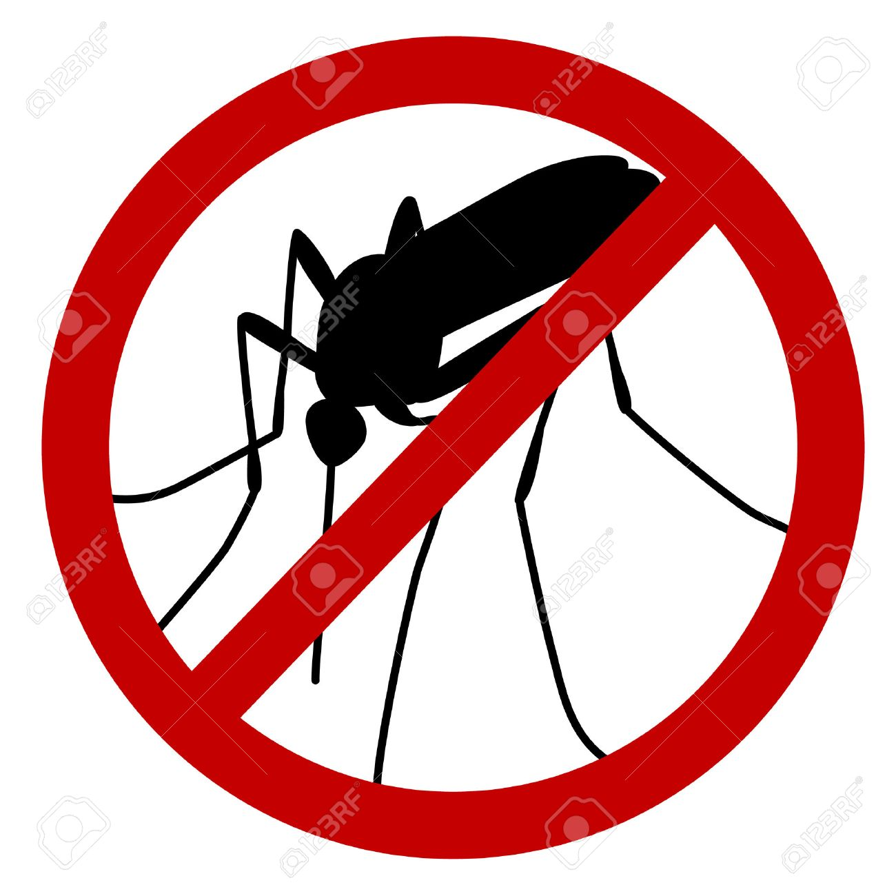
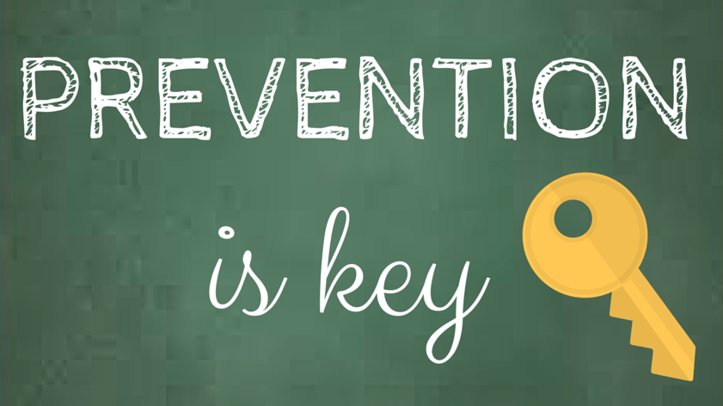
Problem Statement
To predict mosquito hotspots in Chicago using our models.
Propose solutions to stop and prevent these hotspots from breeding mosquitoes

Slide 5
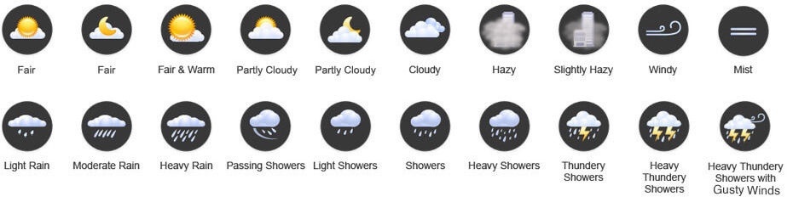
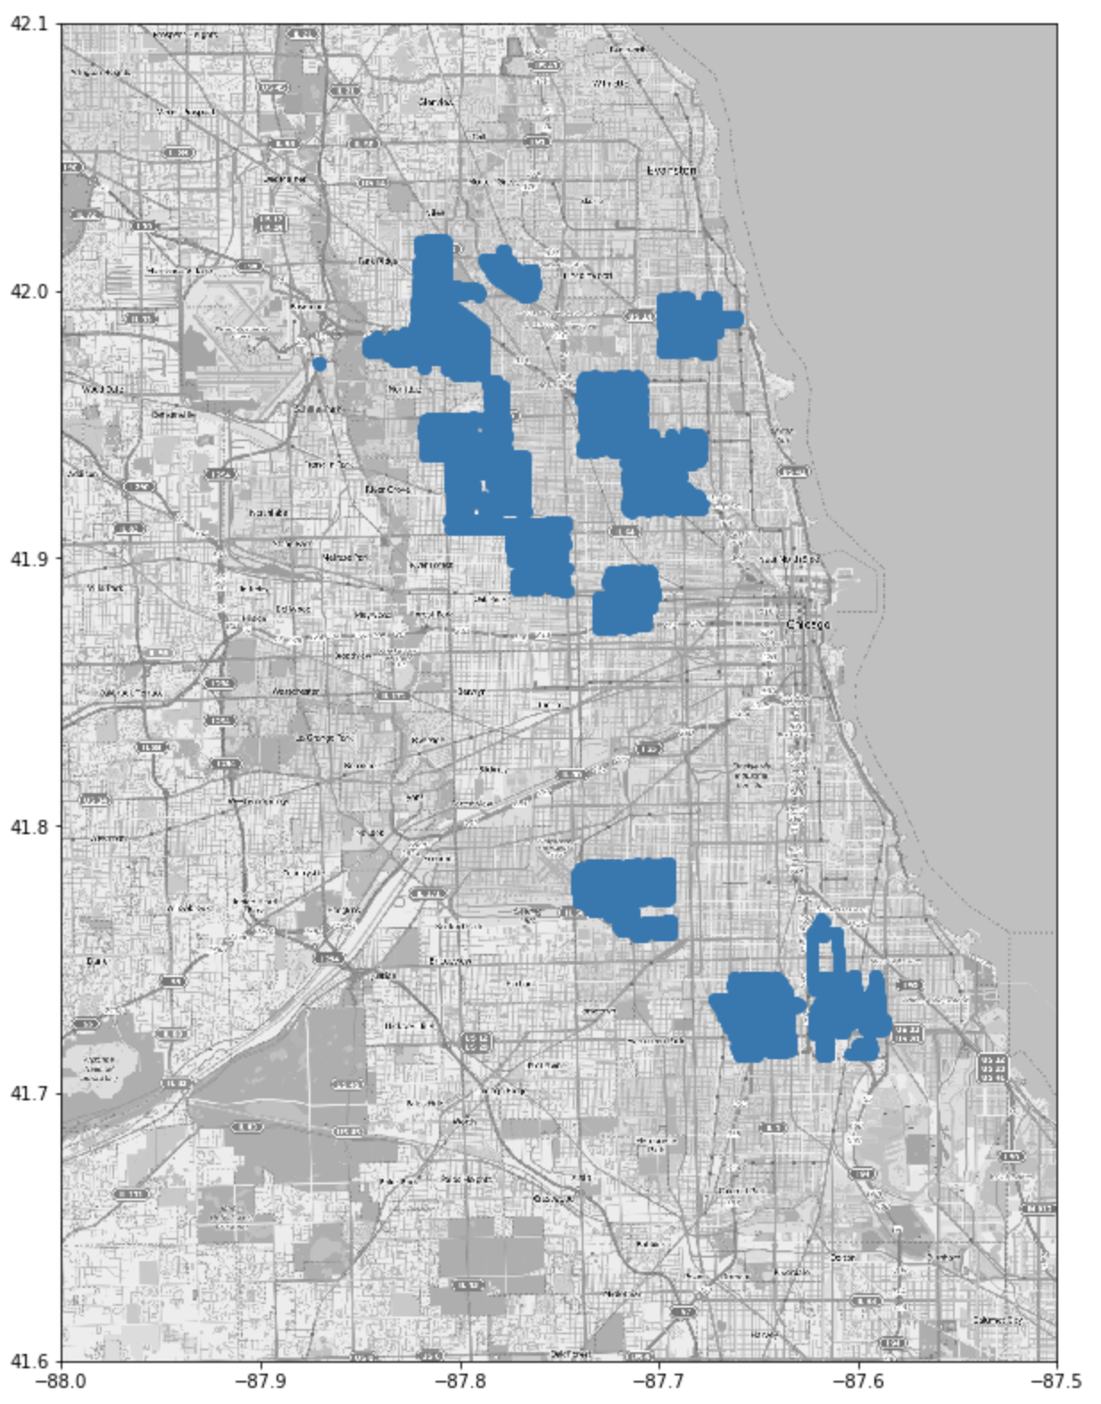
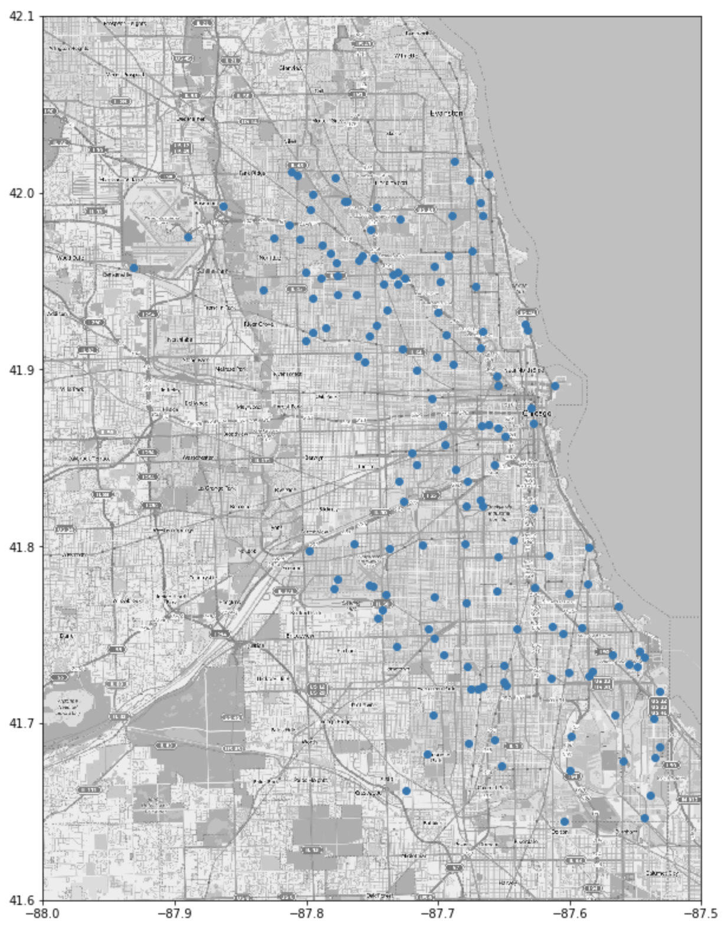
Data and constraints
Datasets:
Weather data from
May to Oct , 2007 – 2014
Spraying data for year 2011 and 2013
Traps collection data from May to Oct, 2007 – 2014

Slide 6
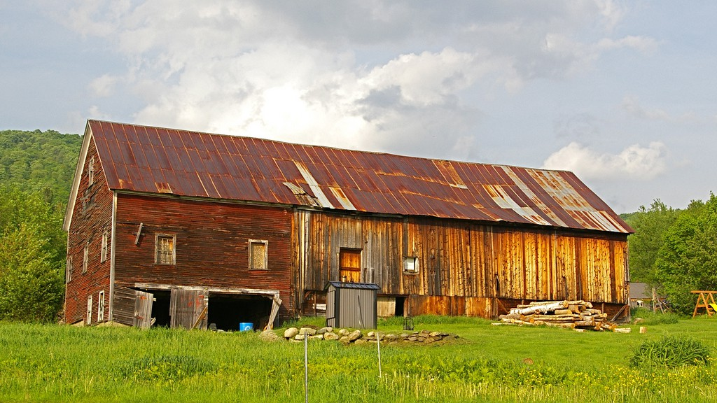
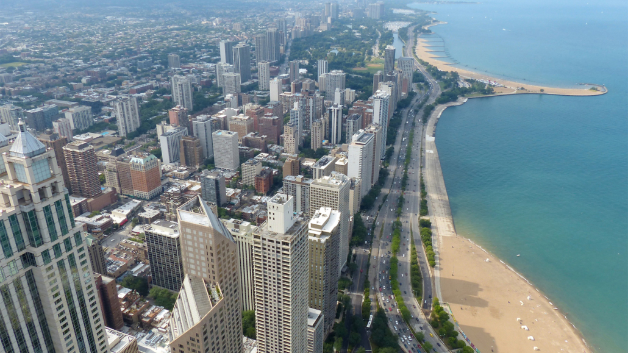
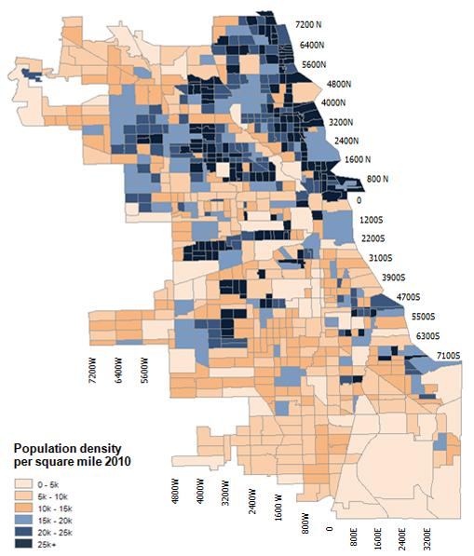

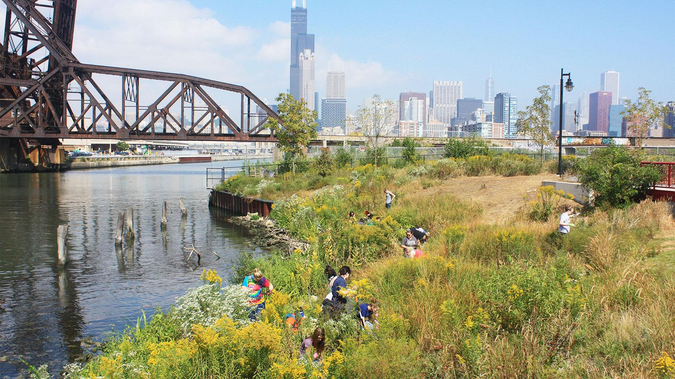
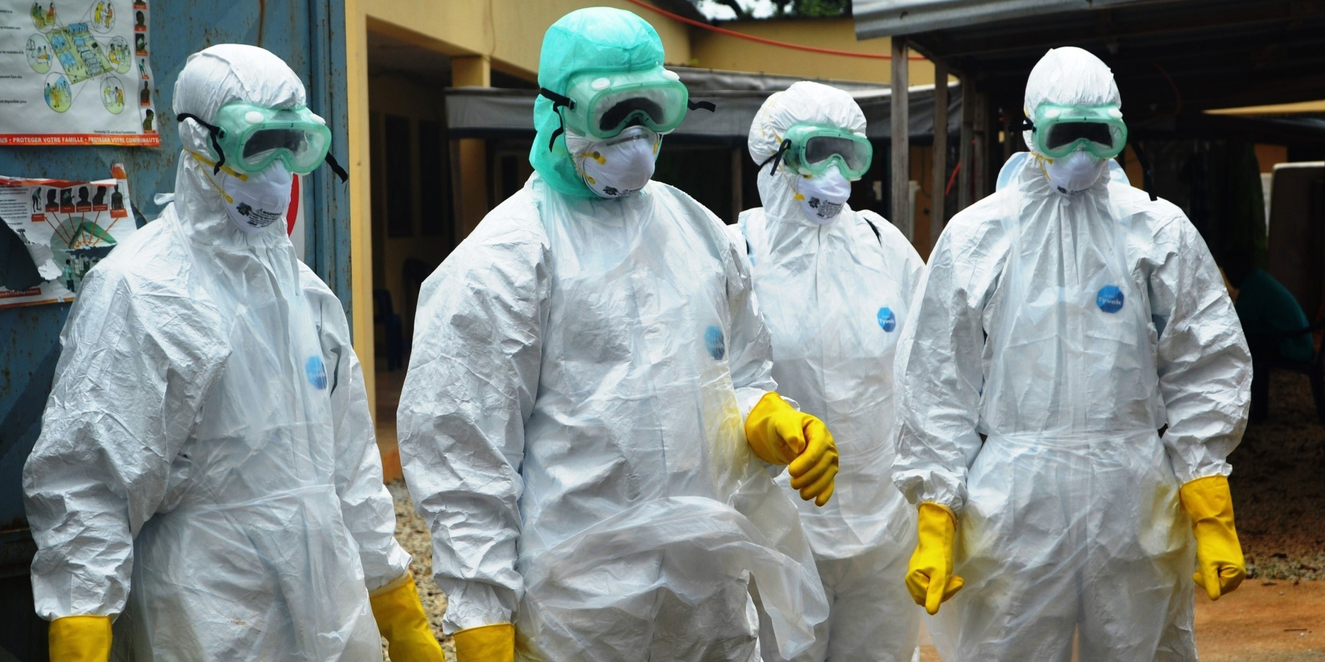
Data and constraints
Constraints:
Based on this spray data alone, we have no information where spraying were done in 2012 and 2014
Absence of population density, urban / rural area, infection rates, infected population
There is no clear link between spraying data & the event of WNV case present in the sprayed locations.

Slide 7
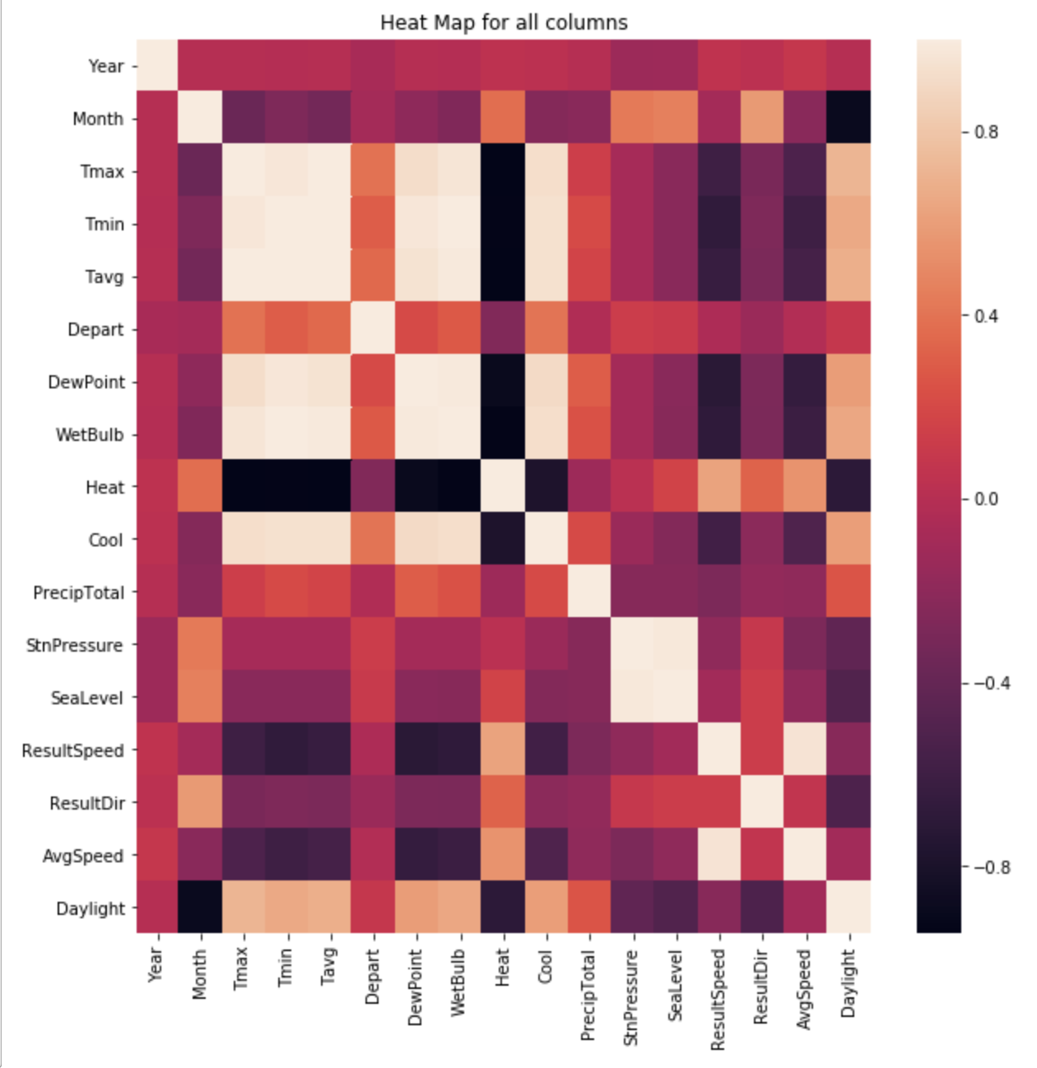
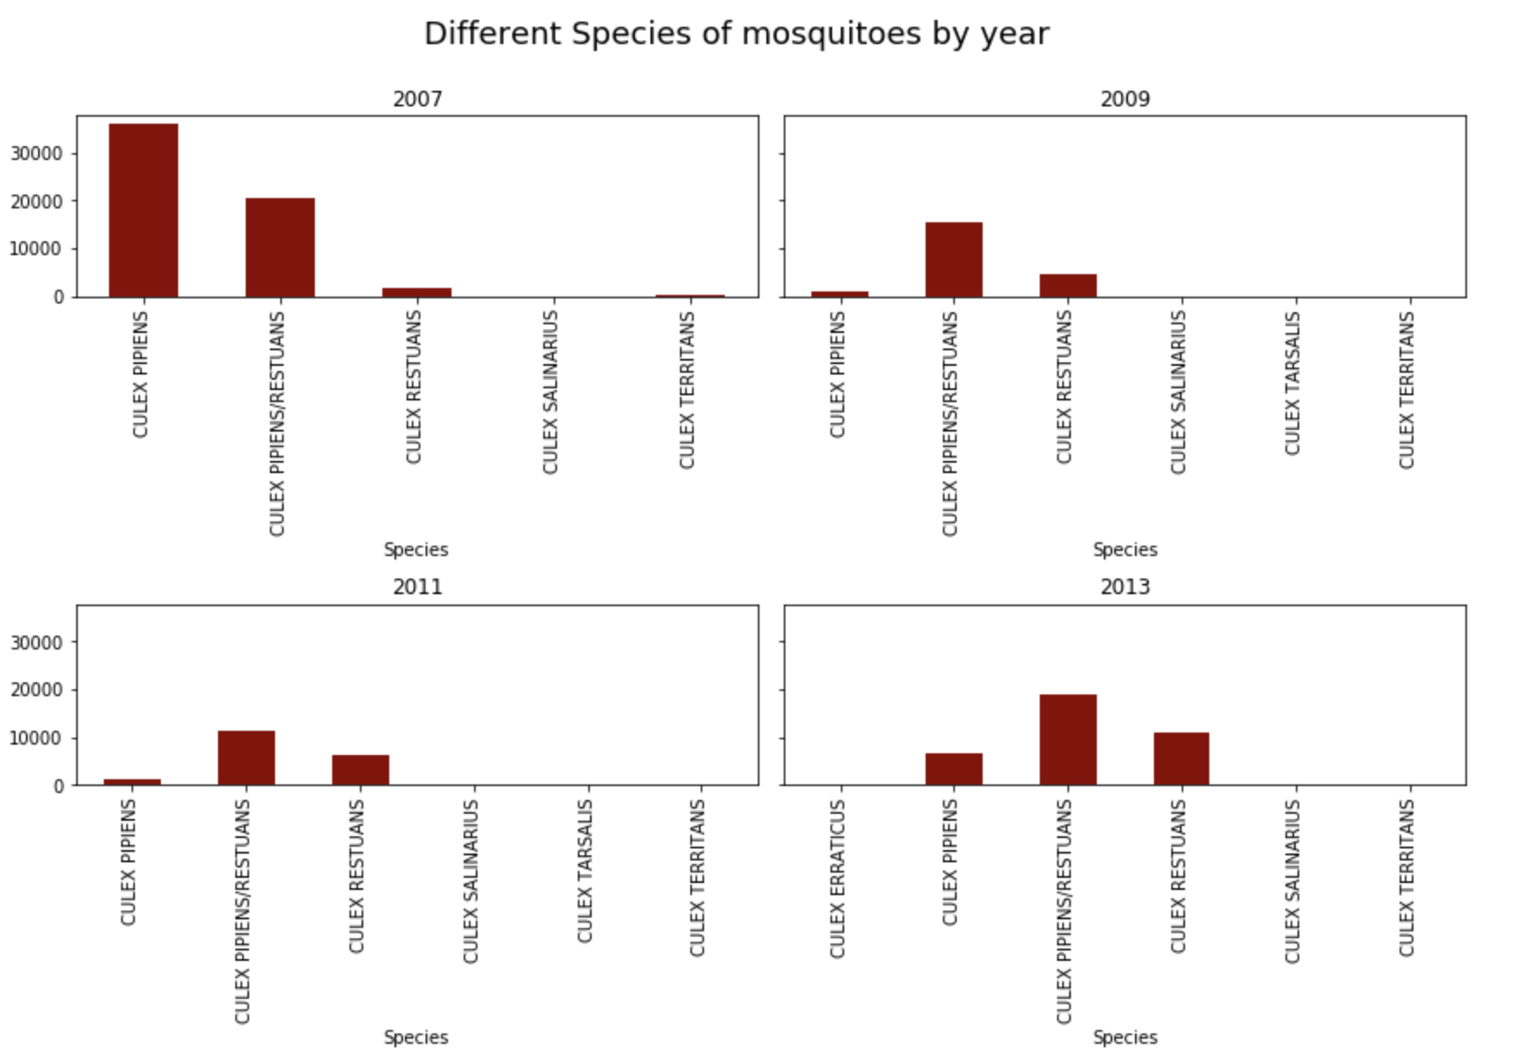
Modelling
Weather:
New features: weeks, daylight,
Using Principal Component Analysis (PCA) for temperature features and also others
Hot-coded Weather codes
Hot-coded Weather codes
Traps collection data:
Hot-coded species of mosquitoes
Overall data:
Oversample on virus occurrence
Principal Component Analysis (PCA) for temperature features and others

Slide 8
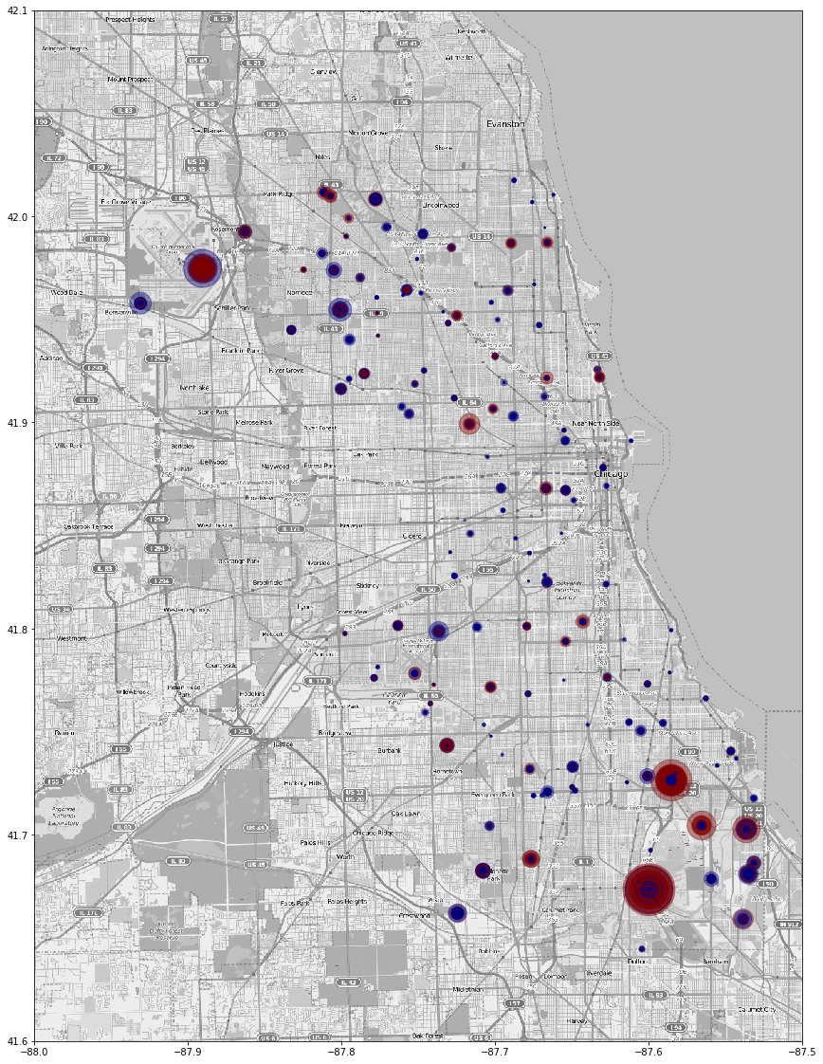
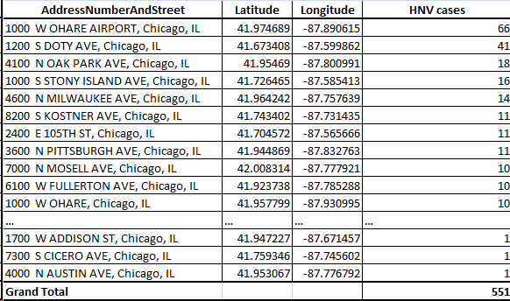
Modelling
Size of circle represents numbers of mosquitos
Blue: areas with no west nile virus
Red: areas with west nile virus
Traps collection data:
From the dataset, we are able to identify certain hotspots and areas with huge numbers of mosquitoes

Slide 9
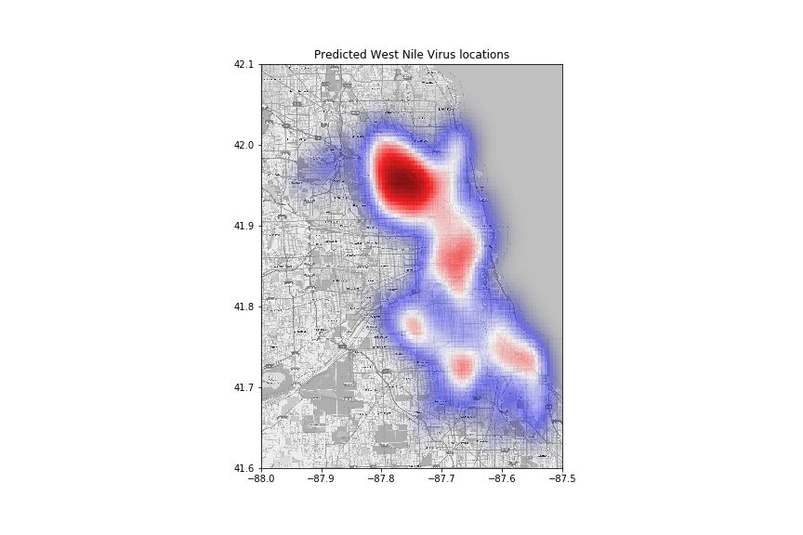
Prediction and Results
Red: areas with higher probability of infection
Predictions:
These are the areas with high probability of getting infected with West Nile Virus
1000 W OHARE AIRPORT
9100 W HIGGINS RD
3600 N PITTSBURGH AVE
7900 W FOSTER AVE,
5200 S NORDICA
7000 W ARMITAGE AVENUE
6300 W 64TH ST
7200 N OKETO AVE
5100 N MONT CLARE AVE
6100 S MELVINA AVE

Slide 10
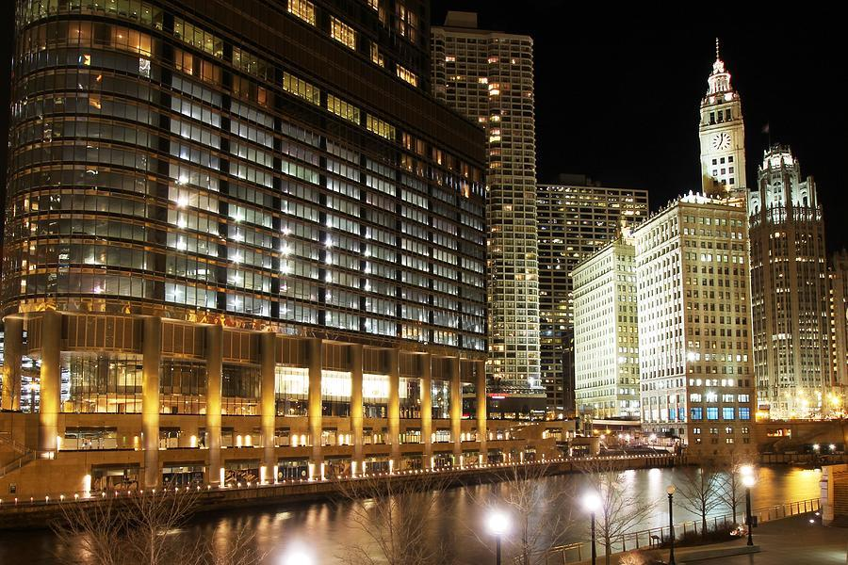
To Spray or not to Spray?
#FightTheBite

Slide 11
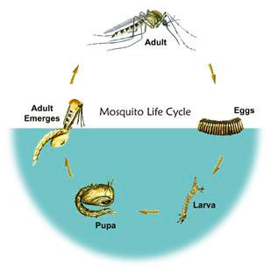
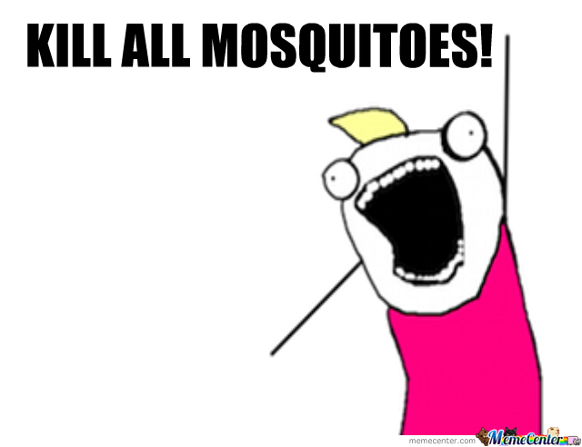
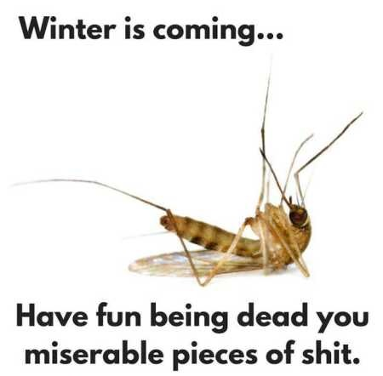
Timing
When should mosquitoes be EXTERMINATED
Culex Species- vectors of WNV
Eggs to Pupa: Between 4-10 days
Adult (female) lifespan can last from 10 - 50days
Notes:
CULEX species can hibernate?!??

Slide 12
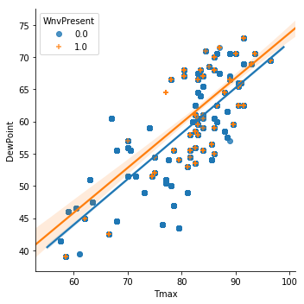
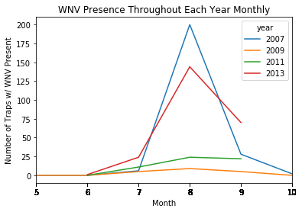
Timing
When to EXTERMINATE the buggers
Spike in WMV usually in Summer months (from Jul to Sep)
Probably attributed to the higher temperatures, humidity and drier months
Notes:
https://www.chicago.gov/city/en/depts/cdph/supp_info/infectious/west_nile_virus_surveillancereports2011.html

Slide 13
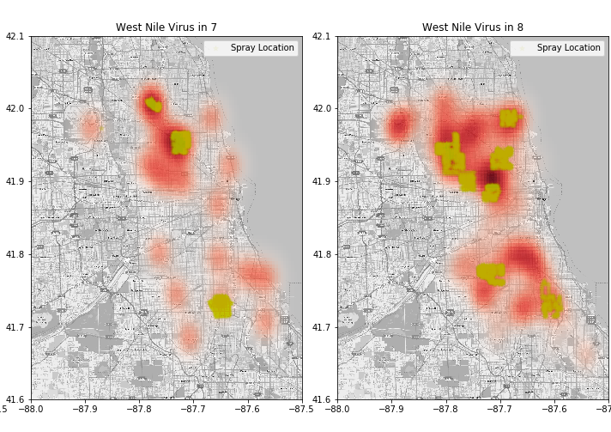
Location
Where was the spraying
WNV Zones vs Spray Locations in 2013 (Jul, Aug)
West Nile Virus in July
West Nile Virus in Aug
WNV Positive
Spray Locations
Notes:
Explain spray <<< affected areas
NO good!!

Slide 14
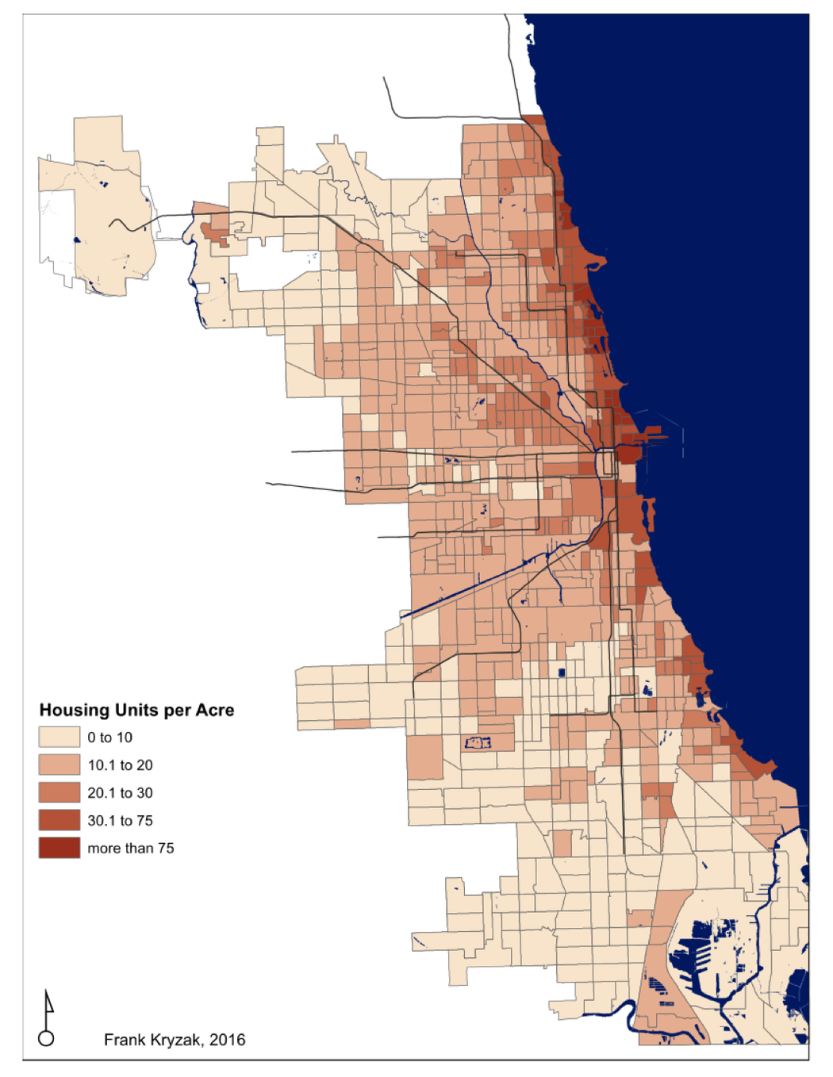
Location
Where do we spray
Notes:
https://chicagoflaneur.com/2016/06/20/a-different-way-of-looking-at-density-in-chicago/
https://www.sporcle.com/games/No1LesbroinChi/populated_chicago_neighborhoods/results
https://www.sciencedaily.com/releases/2014/02/140210184713.htm
https://www.mayoclinic.org/diseases-conditions/west-nile-virus/symptoms-causes/syc-20350320
the period between when you're bitten by an infected mosquito and the appearance of signs and symptoms of the illness — ranges from two to 14 days.
The 37,088 WNV disease cases reported to CDC from 1999 through 2012 included more than 16,000 patients with neurologic disease, over 18,000 patients who required hospitalization, and over 1,500 deaths. July 25, 2018. -first spray in 2018
-According to the CDC, individuals over 50 years of age are more likely to develop severe neurologic disease if infected.
There are no medications to treat it and no vaccines to prevent it. Medical care can be expensive -- tens of thousands of dollars, for example, for those who suffer from partial or whole body paralysis. The study said patients who were hospitalized “were absent from work or school for a median 42 days.”

Slide 15
Confusion Matrix
Weighing the Costs of Inaccuracy - False Positive & False Negative
WNV predicted
But don’t have
WNV NOT predicted
But actually have
An increase in spraying that is not needed
Increased chances of human epidemic
Quarantined- productivity lost and fear
Huge negative economic impacts downstream

Slide 16


Confusion Matrix
Model Performance
Error Matrix |  | Actual West Nile Virus
 |  | WNV Present | WNV Not Present
Our Model Predictions | WNV Present | 97 | 457
 | WNV Not Present | 68 | 2530
Notes:
Our model numbers
Emphasize on the False cases and hw it leads to waste of resources

Slide 17
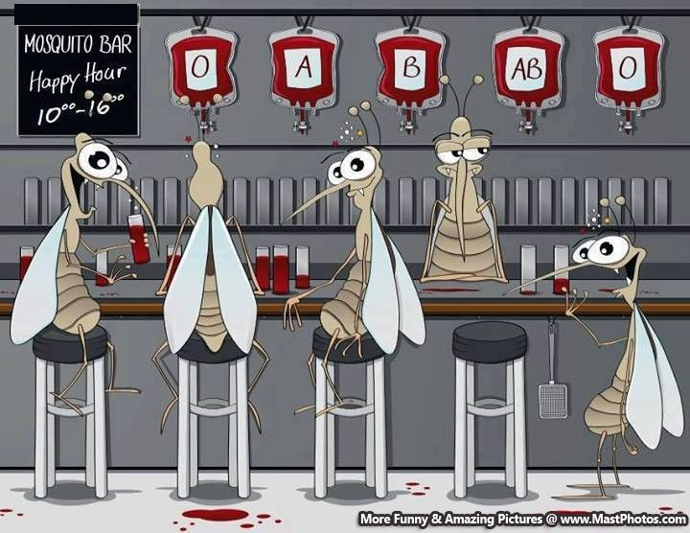
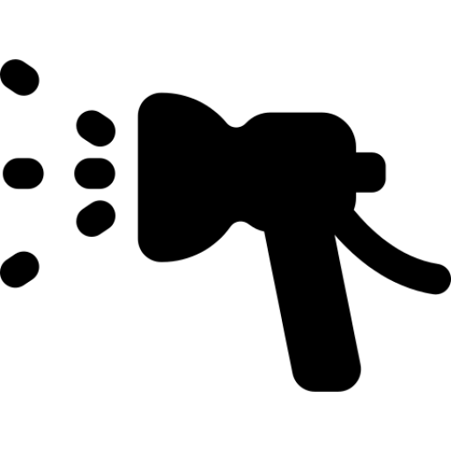
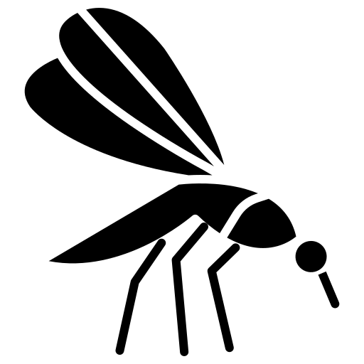
The Cost - Benefit Analysis
SPRAY
DON’T SPRAY
~94 sq miles to spray (40% of total Chicago size)
Spraying cost of $11k per sq mile
Total $1.03million to spray
Reduced WNV by 73 from 117 to 44 cases between 2013 and 2014
Each infected person will cost ~$24k for treatment and productivity loss
Total ~$1.75 million in economic losses
Intangible losses such as tourism numbers and fear of infection cannot be quantified
Notes:
Based on WNV stats from 1999- 2012
breakeven of 40pax for one spray

Slide 18


The Cost - Benefit Analysis
SPRAY VS DON’T SPRAY
$720,000
Cost Savings
Less Sick people
Num. of Mosquitoes to 66%
Notes:
Roughly 234 mile predicted to have West Nile Virus
In the densely populated northern areas of Chicago
At least 300k population
Estimated spraying cost??
834m medical cost from 1999-2012 (including complications and not initial)
37000 affectedx
$23,500/pax
2013-117, 2014-44
We save 1.72m
Cost of spray is ~11k ($300 to $19k)- we take mean
Based on predicted areas, we spray 40% of Chicago = 0.4 * 234 * 11000= 1.02m
Savings = 700K
AND reduce deaths- no cost to saving lives

Slide 19
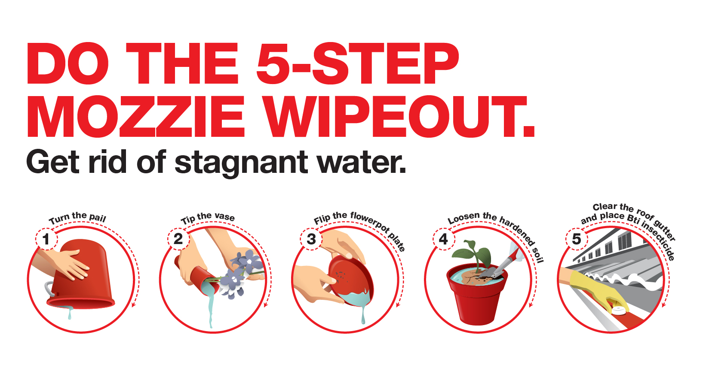
Recommendations
INTENSE mosquito control measures at all stages of a CULEX mosquito species
Currently, Chicago’s main spraying program is to spray areas when mosquito traps test positive for two weeks in a row
(Too LATE?– WNV symptoms only appear after at least 2-14 days)
Prior to onset of high temperatures and humidity, we should:
Focus efforts on larviciding (proven to be effective in eliminating the root of all evil by 92% )
Perform initial spraying for predicted affected areas in early July to coincide with the expected rise in adult female mosquitoes
Employ vector control preventive measures once key indicators are met
(e.g. dew point >50, summer temperatures and decreased windspeed)
Increase public education on mosquito control
Deployment of WindyGrid in 2016 for situational awareness,
incident monitoring, historical data retrieval,
and real-time advanced analytics.
Notes:
Source Reduction: the removal of mosquito breeding habitats
Habitat Modification: manipulate habitat to reduce breeding
Bio-control: introducing natural predators of mosquitoes
Larvicide: using pesticides to reduce larval populations
Adulticide: using pesticides to reduce adult populations
A recent study from the Chicago area suggested that mosquito control programs made a difference in WNV infection rates, he said. For example, the Des Plaines Valley district, with an intensive program to kill mosquito larvae, had four West Nile cases per 100,000 people, while the North Shore district, with a less ambitious program, had 51 cases per 100,000.-2004 http://www.cidrap.umn.edu/news-perspective/2004/07/west-nile-magnifies-need-mosquito-control
the period between when you're bitten by an infected mosquito and the appearance of signs and symptoms of the illness — ranges from two to 14 days.
Trapping and spraying isn’t Chicago’s only defense against WNV, either: other efforts include larviciding catch basins, which involves dropping tablets in storm drains along the public way that slowly dissolve over a five-month period to prevent mosquito larvae from hatching, and eliminating standing water by ensuring that swimming pools and construction sites are regularly maintained.
fogging does not prevent mosquitoes from re-entering the area and birds
Fogging will kill only part of the mosquitoes in your area for a few days.
In Chicago’s spraying program—its main effort against WNV—the city sprays areas when CDPH mosquito traps test positive for WNV two weeks in a row.

Slide 20
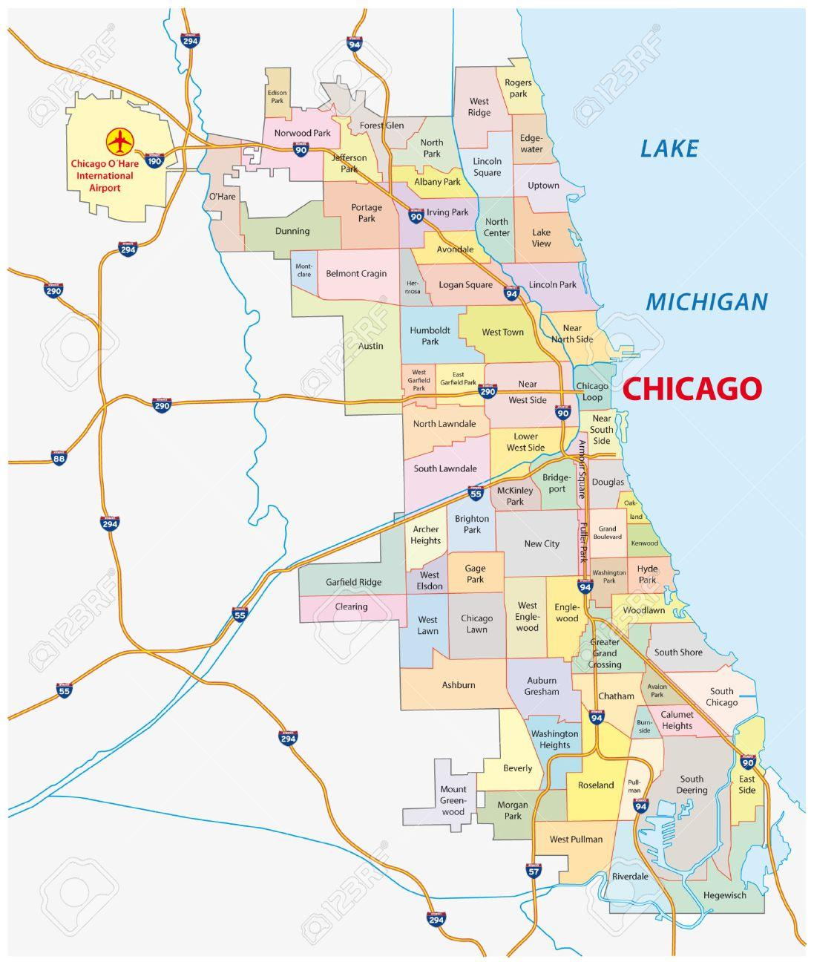
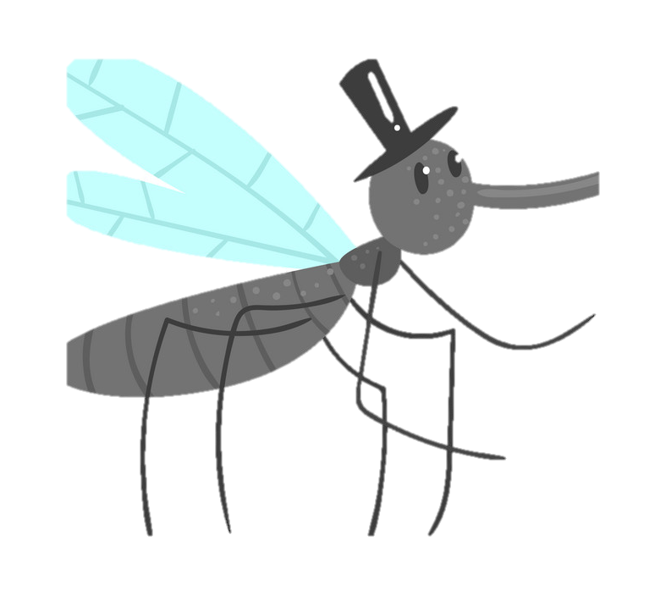
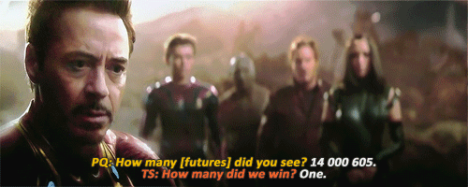
- END -
Notes:
Having a host of WNV-related data ready for analysis presents us with an opportunity,” noted Leynes. “Given this week’s results, can we predict if there will be WNV at a given trap location next week? Building an algorithm that can detect at-risk sites earlier means that we can spray sooner, reducing public exposure to the virus.”

